Slide 1

Data, Methods, and Scenarios
Mining Massive Datasets
Prof. Carlos "ChaTo" Castillo (they/them)
https://github.com/chatox/data-mining-course/

Slide 2
Main Sources
Data Mining, The Textbook (2015) by Charu Aggarwal (Chapter 1) + slides by Lijun Zhang
Mining of Massive Datasets, 2nd edition (2014) by Leskovec et al. (Chapter 1)
Data Mining Concepts and Techniques, 3rd edition (2011) by Han et al. (Chapters 1-2)

Slide 3
Contents
Types of data
Types of problem
Example scenarios
Major challenges

Slide 4
Data types

Slide 5
Nondependency / Dependency
Nondependency oriented data can be structured so items are separate
Relational data, text data
Dependency oriented data includes relationships between items
Graphs, time series

Slide 6
Mixed attribute data
Most attributes we will deal with are numerical, they quantify something
Sometimes attributes are categorical
Example: elephant, tiger, moose, ...
Binary (two categories)
Example: present, absent
Ordinal (two or more categories that can be naturally sorted)
Example: low, medium, high
Real-world datasets include a mixture of types

Slide 7
Binary attributes, sets, dummy vars.
Every binary attribute can be used as a marker of belonging to a set and viceversa
One-hot encoding: every categorical attribute taking one of k values can be encoded as k “dummy” binary attributes
Name | Zip code | Parent | Capacity
Moog | 08001 | NULL | Small
Macarena | 08002 | NULL | Small
Input | 08038 | NULL | Medium
Loft | 08018 | Razzmatazz | Large
Nitsa | 08004 | Apolo | Large

Slide 8

Question
Suppose you encode capacity using one-hot encoding. How many columns will your new dataset have?
Name | Zip code | ParentCo | Capacity
Moog | 08001 | NULL | Small
Macarena | 08002 | NULL | Small
Input | 08038 | NULL | Medium
Loft | 08018 | Razzmatazz | Large
Nitsa | 08004 | Apolo | Large

Slide 9
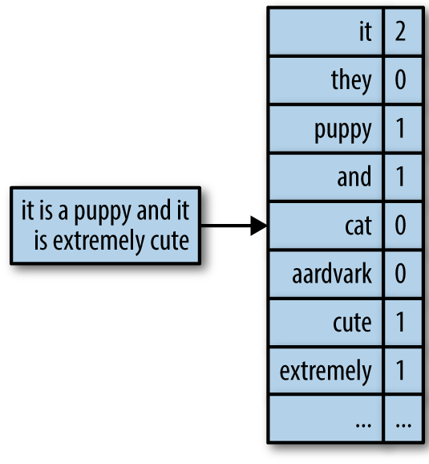
Textual data
Text can be represented as:
As a string
“Bag of words”: a set of binary variables, one for each word in the dictionary, with value True iff the word belongs to the text
“Vector space”: a set of numerical variables indicating number of occurrences (often normalized by collection frequency)
http://uc-r.github.io/creating-text-features

Slide 10
Time series data
Contextual attributes
Timestamps, sequence number, …
Behavioral attributes
Readings of a sensor, value of the variable, …
Multivariate time series data has multiple behavioral attributes

Slide 11
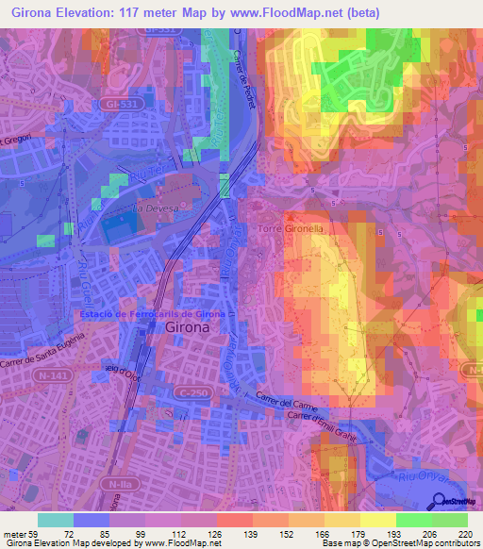
Spatial data
Girona elevation map
Two (lat/long) or three (lat/long/elevation) spatial attributes
This is remote sensing data, including satellite and aerial photos

Slide 12
Spatiotemporal data
Two main representations:
Spatial and temporal attributes are contextual
Example: sea surface temperature
Temporal attribute is contextual, spatial attribute is behavioral
Example: trajectories

Slide 13
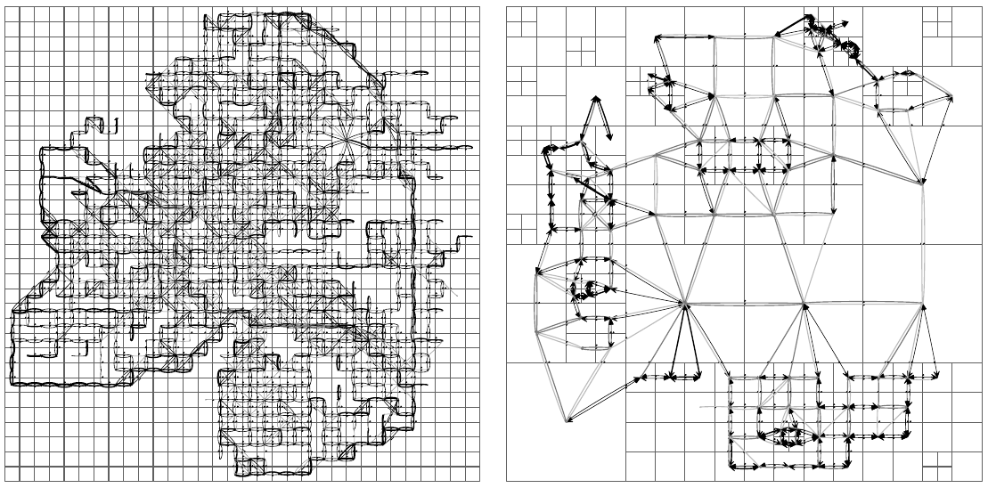
Example: trajectory data aggregation
Bonchi, F., Castillo, C., Donato, D., & Gionis, A. (2009). Taxonomy-driven lumping for sequence mining.
Data Mining and Knowledge Discovery, 19(2), 227-244.

Slide 14
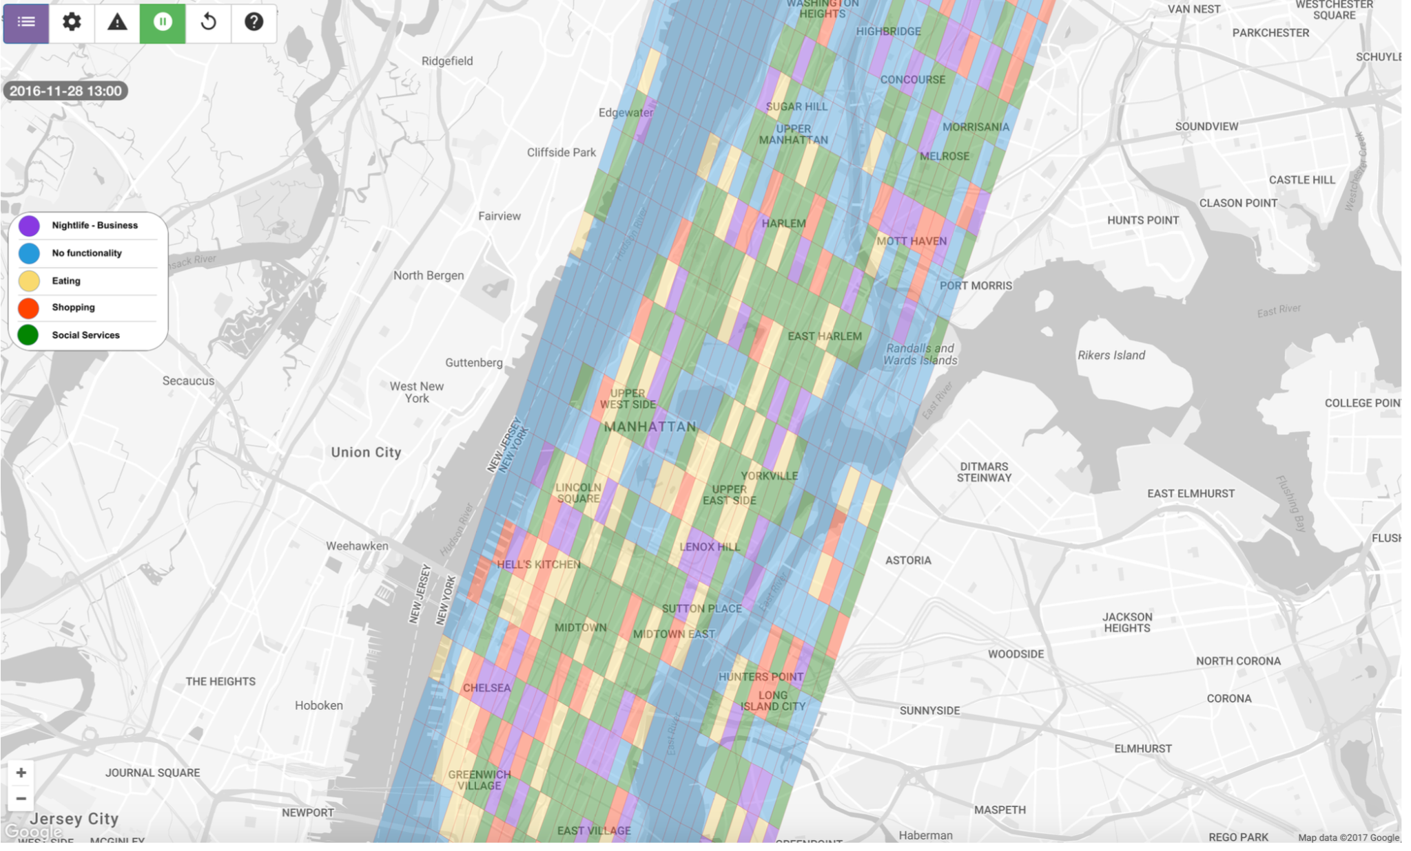
Example: Functional regions in cities
H. Assem, B. Caglayan, T.S. Buda, D. O’Sullivan. ST-DenNetFus: Deep Spatio-Temporal Dense Networks for Network Demand Prediction.
The European Conference on Machine Learning and Principles and Practice of Knowledge Discovery in Databases, 2018

Slide 15
Problem types

Slide 16
Data mining methods try to find relationships
Between columns
Find associations, correlations, …
If there is one key column: classification, prediction, ...
Between rows
Find clusters
Detect outliers

Slide 17
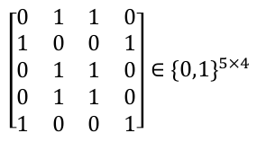
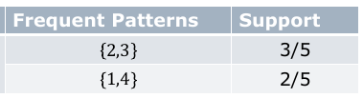
Example: Association pattern mining
Sparse binary databases representing, e.g., items a person is interested in
The relative frequency of a pattern is its support
https://cs.nju.edu.cn/zlj/Course/DM_15.html

Slide 18
Association pattern mining (cont.)
Given a binary n × d data matrix D,
determine all subsets of columns such that all the values in these columns take on the value True for at least a fraction min_support of the rows in the matrix.
The relative frequency of a pattern is referred to as its support

Slide 19
Association pattern mining (cont.)
The confidence of a rule A→B is
support(A U B) / support(A)
Example:
{ Chips, Olives } → { Beer }

Slide 20
Exercise
The confidence of a rule A→B is
support(A U B) / support(A)
Suppose
10 people buy only Chips and Beer
20 people buy only Chips and Olives
30 people buy only Olives and Beer
40 people buy all three: Chips, Olives, and Beer.
What is the confidence of the rule { Chips, Olives } → { Beer } ?

Slide 21
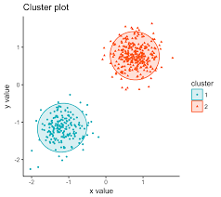
Clustering
Partition records/rows in a way that
elements in the same partition are similar
elements in different partitions are different
Applications:
Segmentation, summarization, …
Sometimes a step in a larger DM algorithm
Image credit: http://www.sthda.com/english/articles/tag/pam-clustering/

Slide 22
Clustering is not easy
What does it mean to be similar?
How many sets?
Can a record/row belong to more than one set?
Can a record/row belong to no set at all? ...
Image credit: sthda.com

Slide 23
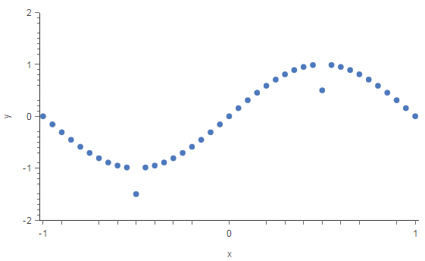
Outlier detection
Given a database, find records/rows that are different from the rest of the database
Applications:
Intrusion detection, credit card fraud, interesting sensor events, medical diagnosis, ...
Image credits: https://www.kdnuggets.com/2017/01/3-methods-deal-outliers.html

Slide 24
Outlier detection is not easy
How different should they be?
How many can be different?
What does it mean to be different?
What should we do with outliers?
Image credits: https://www.kdnuggets.com/2017/01/3-methods-deal-outliers.html

Slide 25
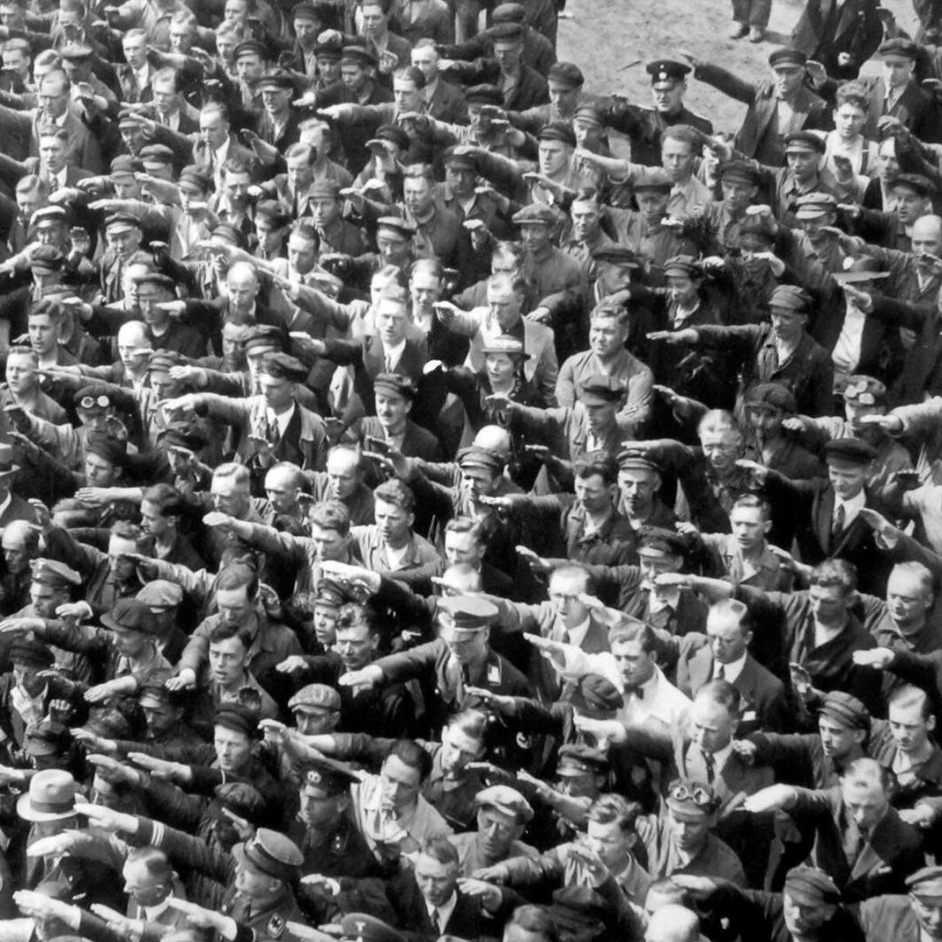
One of my favorite outliers
August Landmesser
August Landmesser in 1936

Slide 26
Data classification
Sometimes data has a feature known as a class label
A model can learn from previous data to associate a record/row to a class label
One of the most useful tools in your belt!

Slide 27
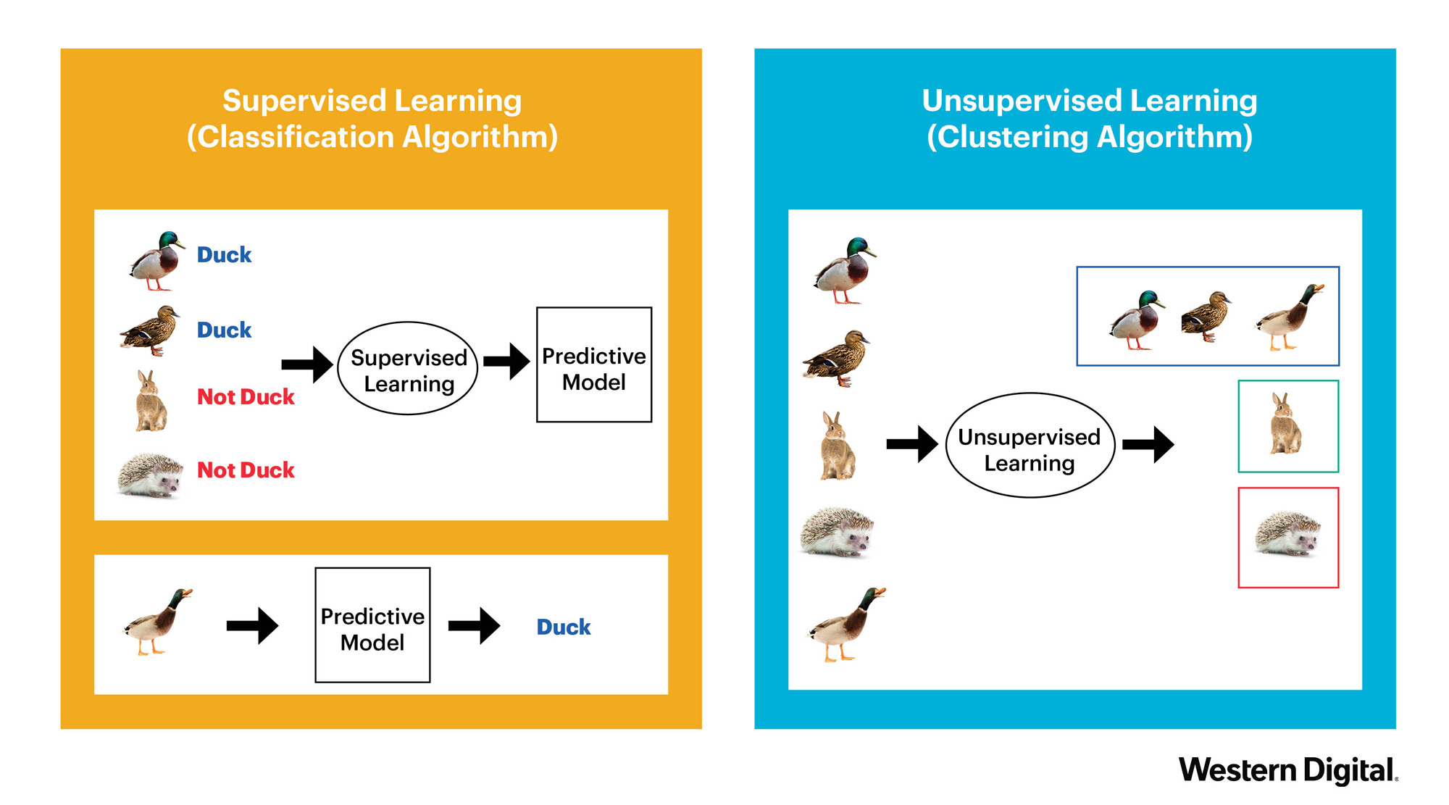

Slide 28
Tasks with complex data types
Frequent temporal patterns
Time series motifs
Graph motifs
Trajectory clusters
Collective classification
...

Slide 29
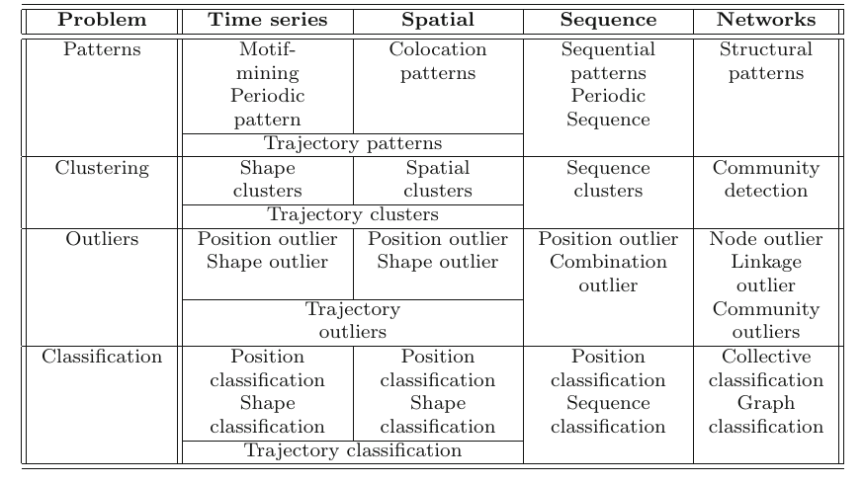
Data types x Prototypical problems
Data Mining, The Textbook (2015) by Charu Aggarwal

Slide 30
Example scenarios

Slide 31

Example scenario 1
Organize products to maximize co-purchases of items frequently bought together
Input data: baskets
Output: similar pairs
Algorithm: frequent pattern mining

Slide 32

Example scenario 2
Recommend media to users (movies, series, music, books, podcasts, …)
Input data: viewing history
Output: recommendations
Simple algorithm: k nearest neighbors

Slide 33
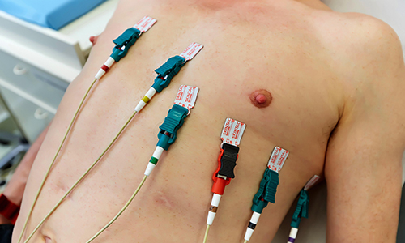
Example scenario 3
Help diagnose if an electrocardiogram is associated to a health problem
Input data: time series, possibly multi-dimensional
Output: binary label or risk score
Algorithms: outlier detection or classification

Slide 34

Example scenario 4
Help a sysadmin determine if an intruder is trying or has accessed the network
Input data: time series of event records
Output: binary label or risk score
Algorithms: event detection

Slide 35

Exercise
Which ones are data mining tasks?
Dividing the customers of a company by postal code
Finding credit card scammers among customers of a company
Computing the total sales of a company
Sorting a student database by student identification number
Predicting the future stock price of a company using past records
Determine when a complex machine needs to be repaired
Extracting the frequencies of a sound wave

Slide 36
Major challenges

Slide 37
Methodological challenges
Mining high-dimensional data
Handling uncertainty, noise, incompleteness, ...
Mining data from a domain in which you do not have expertise, or worse, in which you believe you have expertise
Conclusions are often worthless if you do not talk with domain experts

Slide 38
User interaction challenges
Users should ask questions that matter to them
Performing interactive mining
Presenting and visualizing data mining results

Slide 39
Efficiency and scalability
Even for polynomial-running-time algorithms, a process can become
unreasonably slow or
require an unreasonable amount of space
Streaming and/or distributed mining algorithms can help to some extent

Slide 40
Diversity of database types
Real databases are
high dimensional and involve a
mixture of various data types
Sometimes you need to integrate from
dynamic, or
distributed data sources

Slide 41

Data mining can be harmful
Social impacts of data mining
Who wins? And more importantly, who loses?
Privacy-preserving data mining
Avoid invisible, pervasive, invasive data mining

Slide 42
Summary

Slide 43
Things to remember
Types of data
Types of data mining methods
Prototypical data mining scenarios
Typical challenges of data mining

Slide 44
Exercises for this topic
Section 1.9 of Data Mining, The Textbook (2015) by Charu Aggarwal
Exercises 1.7 of Introduction to Data Mining, Second Edition (2019) by Tan et al.

Slide 45
Answer: 6 columns
Name
Zipcode
Parent
Capacity_Small
Capacity_Medium
Capacity_Large

Slide 46
Answer
The confidence of a rule A→B is: support(A U B) / support(A)
Suppose
10 people buy only Chips and Beer
20 people buy only Chips and Olives
30 people buy only Olives and Beer
40 people buy all three: Chips, Olives, and Beer.
Confidence of the rule { Chips, Olives } → { Beer } ?
support({Chip, Olives, Beer} / support({Chip, Olives}) = 40 / (40+20) = 2/3

Slide 47
Answers
Dividing the customers of a company by postal code
Finding credit card scammers among customers of a company
Computing the total sales of a company
Sorting a student database by student identification number
Predicting the future stock price of a company using past records
Determine when a complex machine needs to be repaired
Extracting the frequencies of a sound wave

